Slide 1
K-Means

Slide 2
What is K – Means?
K-means clustering is one of the simplest and popular unsupervised machine learning algorithms.
Typically, unsupervised algorithms make inferences from datasets using only input vectors without referring to known, or labelled, outcomes.
“The objective of K-means is simple: group similar data points together and discover underlying patterns. To achieve this objective, K-means looks for a fixed number (k) of clusters in a dataset.”
Define a target number k, which refers to the number of centroids you need in the dataset.
A centroid is the imaginary or real location representing the center of the cluster.

Slide 3

Every data point is allocated to each of the clusters through reducing the in-cluster sum of squares.
In other words, the K-means algorithm identifies k number of centroids, and then allocates every data point to the nearest cluster, while keeping the centroids as small as possible.
The ‘means’ in the K-means refers to averaging of the data; that is, finding the centroid.

Slide 4

There is an algorithm that tries to minimize the distance of the points in a cluster with their centroid – the k-means clustering technique.
K-means is a centroid-based algorithm, or a distance-based algorithm, where we calculate the distances to assign a point to a cluster. In K-Means, each cluster is associated with a centroid.
The main objective of the K-Means algorithm is to minimize the sum of distances between the points and their respective cluster centroid.

Slide 5
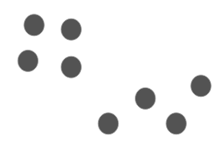
Let’s now take an example to understand how K-Means actually works:
We have these 8 points and we want to apply k-means to create clusters for these points. Here’s how we can do it.

Slide 6
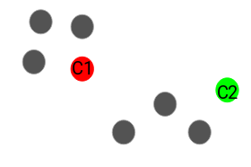
Step 1: Choose the number of clusters k
The first step in k-means is to pick the number of clusters, k.
Step 2: Select k random points from the data as centroids
Next, we randomly select the centroid for each cluster. Let’s say we want to have 2 clusters, so k is equal to 2 here. We then randomly select the centroid:
Here, the red and green circles represent the centroid for these clusters.

Slide 7
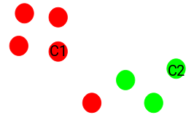
Step 3: Assign all the points to the closest cluster centroid
Once we have initialized the centroids, we assign each point to the closest cluster centroid:
Here you can see that the points which are closer to the red point are assigned to the red cluster whereas the points which are closer to the green point are assigned to the green cluster.

Slide 8
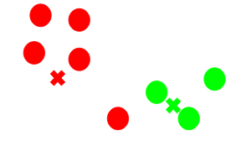
Step 4: Recompute the centroids of newly formed clusters
Now, once we have assigned all of the points to either cluster, the next step is to compute the centroids of newly formed clusters:
Here, the red and green crosses are the new centroids.

Slide 9
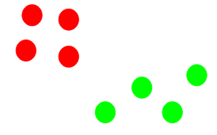
Step 5: Repeat steps 3 and 4
We then repeat steps 3 and 4:
The step of computing the centroid and assigning all the points to the cluster based on their distance from the centroid is a single iteration. But wait – when should we stop this process? It can’t run till eternity, right?

Slide 10
Stopping Criteria for K-Means Clustering
There are essentially three stopping criteria that can be adopted to stop the K-means algorithm:
Centroids of newly formed clusters do not change
Points remain in the same cluster
Maximum number of iterations are reached

Slide 11
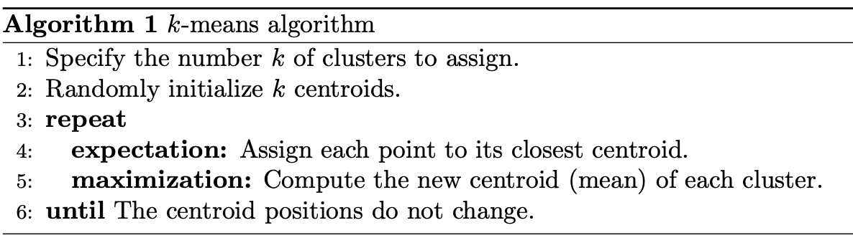

Slide 12
Implementing K- Means using Python
Step 1: Import libraries
Step 2: Generate random data
Step 3: Use Scikit-Learn
Step 4: Finding the centroid
Step 5: Testing the algorithm

Slide 13
Importing Libraries
Import the following libraries in our project:
Pandas for reading and writing spreadsheets
Numpy for carrying out efficient computations
Matplotlib for visualization of data
import pandas as pd
import numpy as np
import matplotlib.pyplot as plt
from sklearn.cluster import KMeans
%matplotlib inline

Slide 14
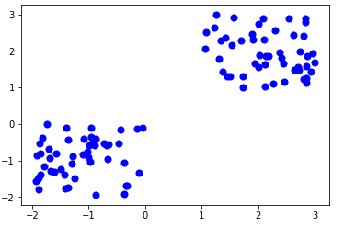
Generate random data
Here is the code for generating some random data in a two-dimensional space
A total of 100 data points has been generated and divided into two groups, of 50 points each.
X= -2 * np.random.rand(100,2)
X1 = 1 + 2 * np.random.rand(50,2)
X[50:100, :] = X1
plt.scatter(X[ : , 0], X[ :, 1], s = 50, c = ‘b’)
plt.show()

Slide 15
Use Scikit-Learn
Use some of the available functions in the Scikit-learn library to process the randomly generated data.
In this case, we arbitrarily gave k (n_clusters) an arbitrary value of two.
Here is the output of the K-means parameters we get if we run the code:
from sklearn.cluster import KMeans
Kmean = KMeans(n_clusters=2)
Kmean.fit(X)
KMeans(algorithm=’auto’, copy_x=True, init=’k-means++’, max_iter=300
n_clusters=2, n_init=10, n_jobs=1, precompute_distances=’auto’,
random_state=None, tol=0.0001, verbose=0)

Slide 16
Finding the centroid
Here is the code for finding the center of the clusters
Here is the result of the value of the centroids:
Kmean.cluster_centers_
array([[-0.94665068, -0.97138368],
[ 2.01559419, 2.02597093]])

Slide 17
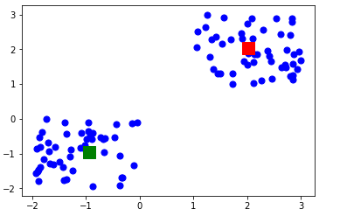
Let’s display the cluster centroids (using green and red color).
plt.scatter(X[ : , 0], X[ : , 1], s =50, c=’b’)
plt.scatter(-0.94665068, -0.97138368, s=200, c=’g’, marker=’s’)
plt.scatter(2.01559419, 2.02597093, s=200, c=’r’, marker=’s’)
plt.show()

Slide 18
Testing the algorithm
Here is the code for getting the labels property of the K-means clustering example dataset; that is, how the data points are categorized into the two clusters
Here is the result of running the above K-means algorithm code
As you can see above, 50 data points belong to the 0 cluster while the rest belong to the 1 cluster.
Kmean.labels_
array([0, 0, 0, 0, 0, 0, 0, 0, 0, 0, 0, 0, 0, 0, 0, 0, 0, 0, 0, 0, 0, 0,
0, 0, 0, 0, 0, 0, 0, 0, 0, 0, 0, 0, 0, 0, 0, 0, 0, 0, 0, 0, 0, 0,
0, 0, 0, 0, 0, 0, 1, 1, 1, 1, 1, 1, 1, 1, 1, 1, 1, 1, 1, 1, 1, 1,
1, 1, 1, 1, 1, 1, 1, 1, 1, 1, 1, 1, 1, 1, 1, 1, 1, 1, 1, 1, 1, 1,
1, 1, 1, 1, 1, 1, 1, 1, 1, 1, 1, 1])

